Slide 1
Interactive apps in R (From Shiny apps to Flexdashboards)
Wednesday 24th August 2022
Any questions please email me at: pablo.leonrodenas@nhs.net

Slide 2
Designing interactive web apps
Shiny is an R package that makes it easy to build interactive web applications (apps) in R.
It is a solution to turn static R scripts into interactive web based apps.
Install and load Shiny package from CRAN to access shiny apps set of functions
Install.packages(“shiny”)
library(shiny)
Once a shiny app is designed and deployed, it can be launched locally from any internet browser or hosted in the Shiny server to be accessed 24/7.

Slide 3
Shiny app components (UI, SERVER)
USER INTERFACE
(Web document. What users see when visiting your website)
SERVER
Set of instructions for the server to follow
This instructions will tell the server what to do when user changes input objects

Slide 4
App template
- Load library
library (shiny)
- Define User Interface (UI)
Ui <- fluidPage()
- Define Server
Server <- function (input, output) {}
- Knits together (UI and SEVER objects) into a Shiny app
shinyApp(ui= ui, server = server)

Slide 5
Build your Shiny app based on Inputs and Outputs
The app is running on a dedicated R session
Inputs: Things that your user can choose and toggle, providing values to the app
Outputs: These are the R objects that user see, these objects change when user changes their input to the app.
UI <- fluidPage(
Input() functions,
Output() functions )
Server <- function (input, output) {
Input() functions,
Output() functions }

Slide 6
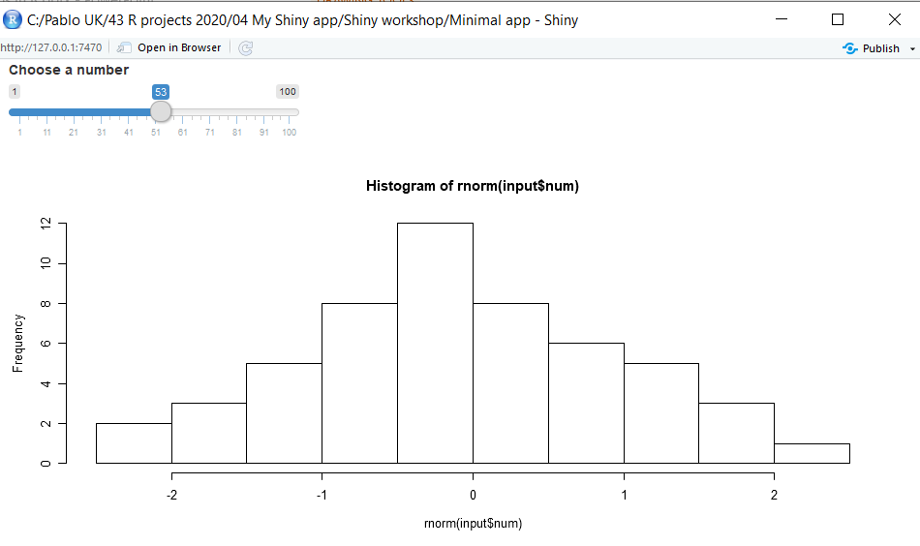
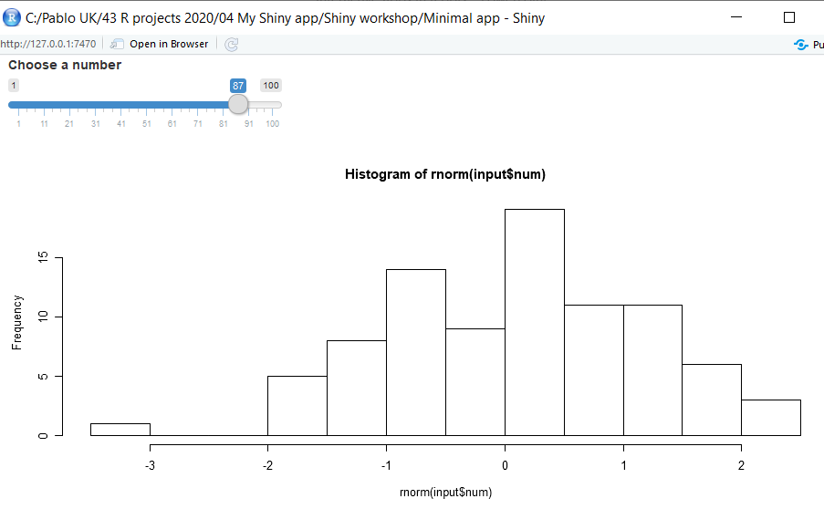
Minimal app
ui <- fluidPage(
# Input
sliderInput(inputId = "num",
label = "Choose a number",
value = 25, min = 1, max = 100),
# Output
plotOutput("hist")
)
server <- function (input, output) {
# Output
output$hist <- renderPlot(
# Input from UI
hist(rnorm(input$num))
)
}
shinyApp(ui= ui, server = server)
Slider set to 53 by user
Reactivity occurs when using an input object to render an output object.
Slider set to 87 by user

Slide 7
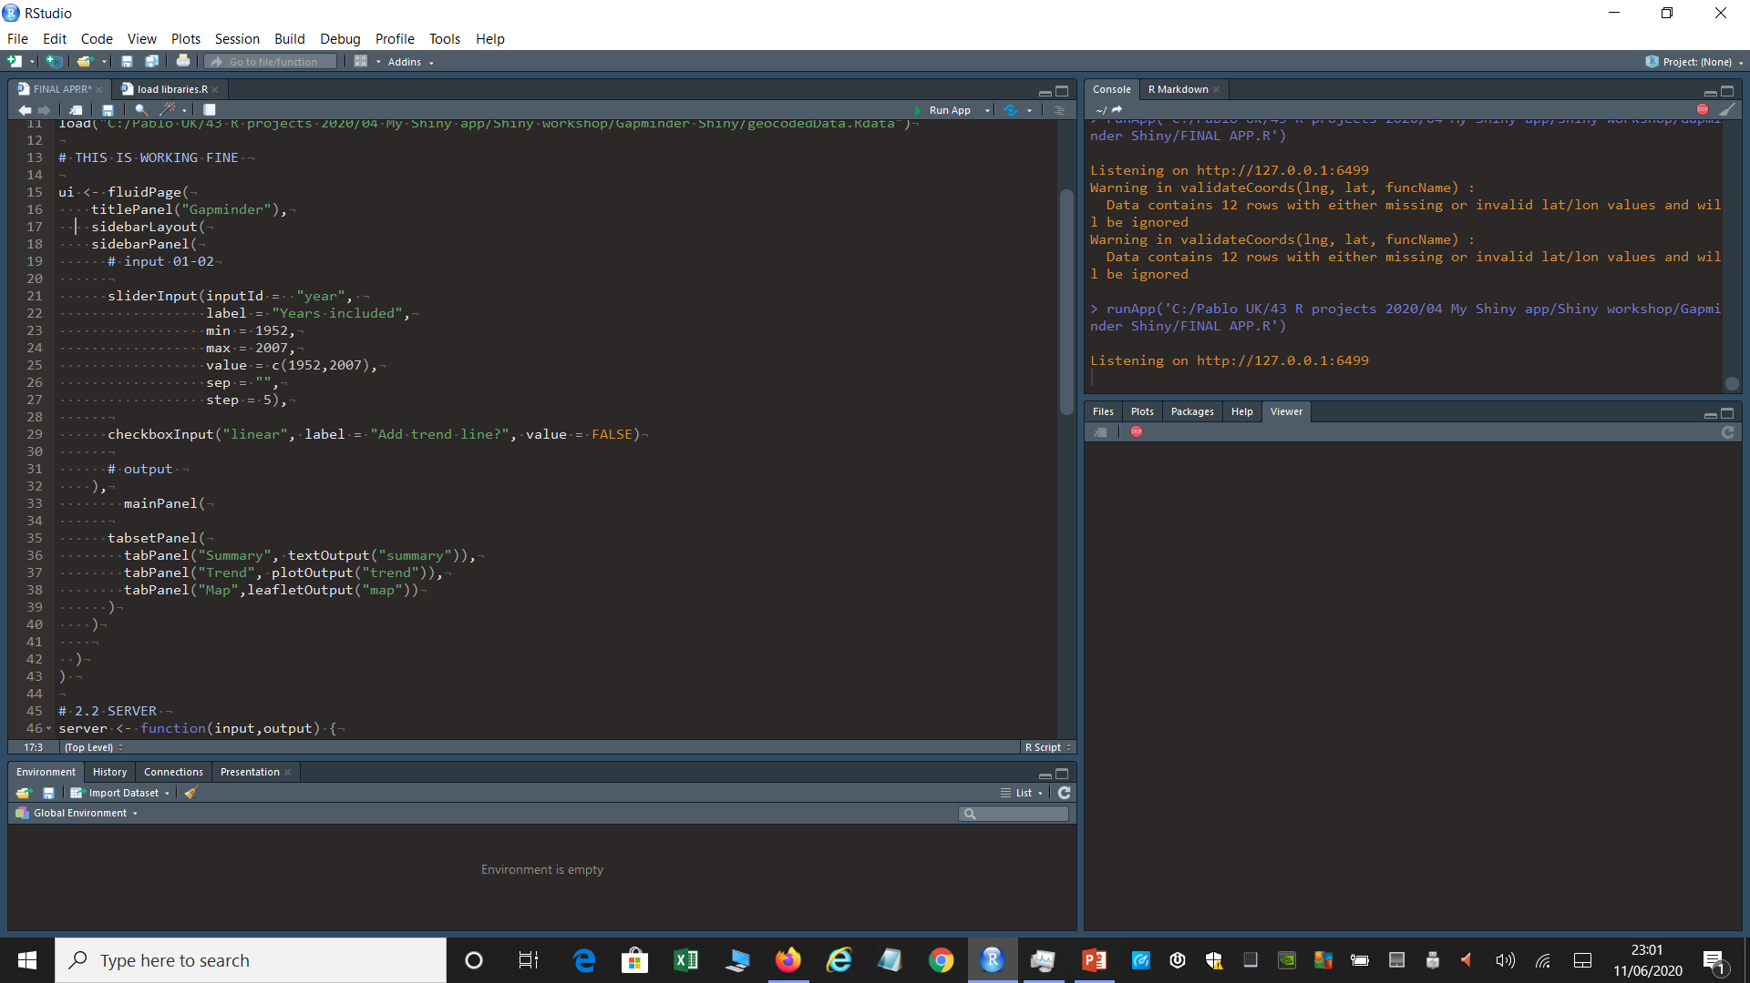
Gapminder Shiny APP (UI script)
This is the script UI and Server (all combined into app.R script)

Slide 8
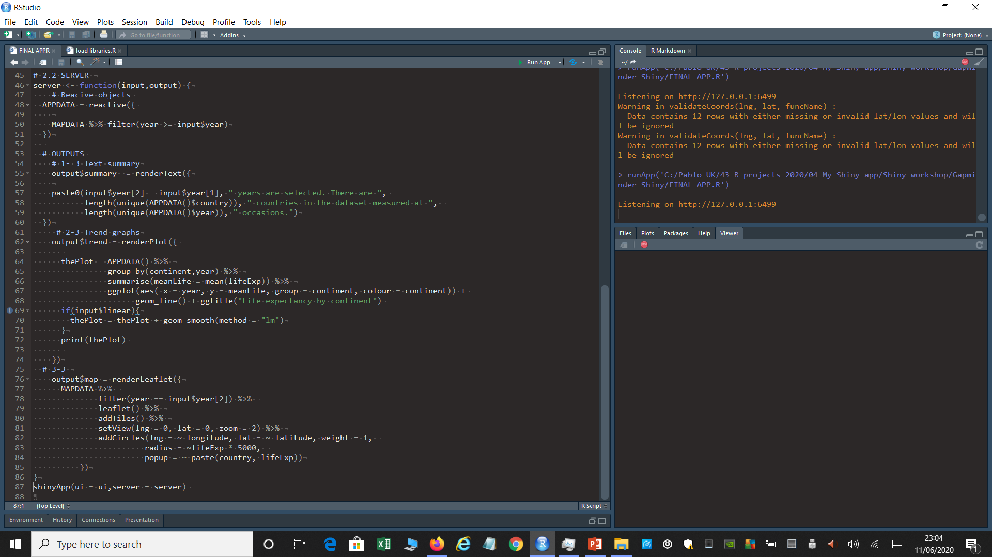
Gapminder Shiny APP (SERVER script)
This is the script UI and Server (all combined into app.R script)

Slide 9
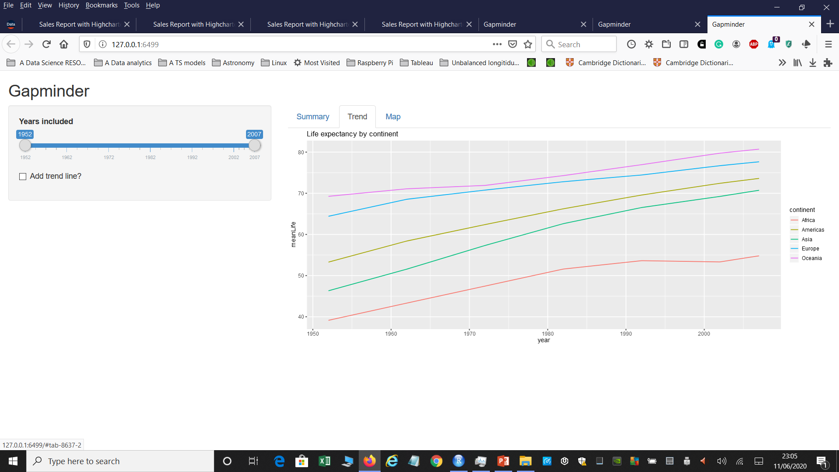
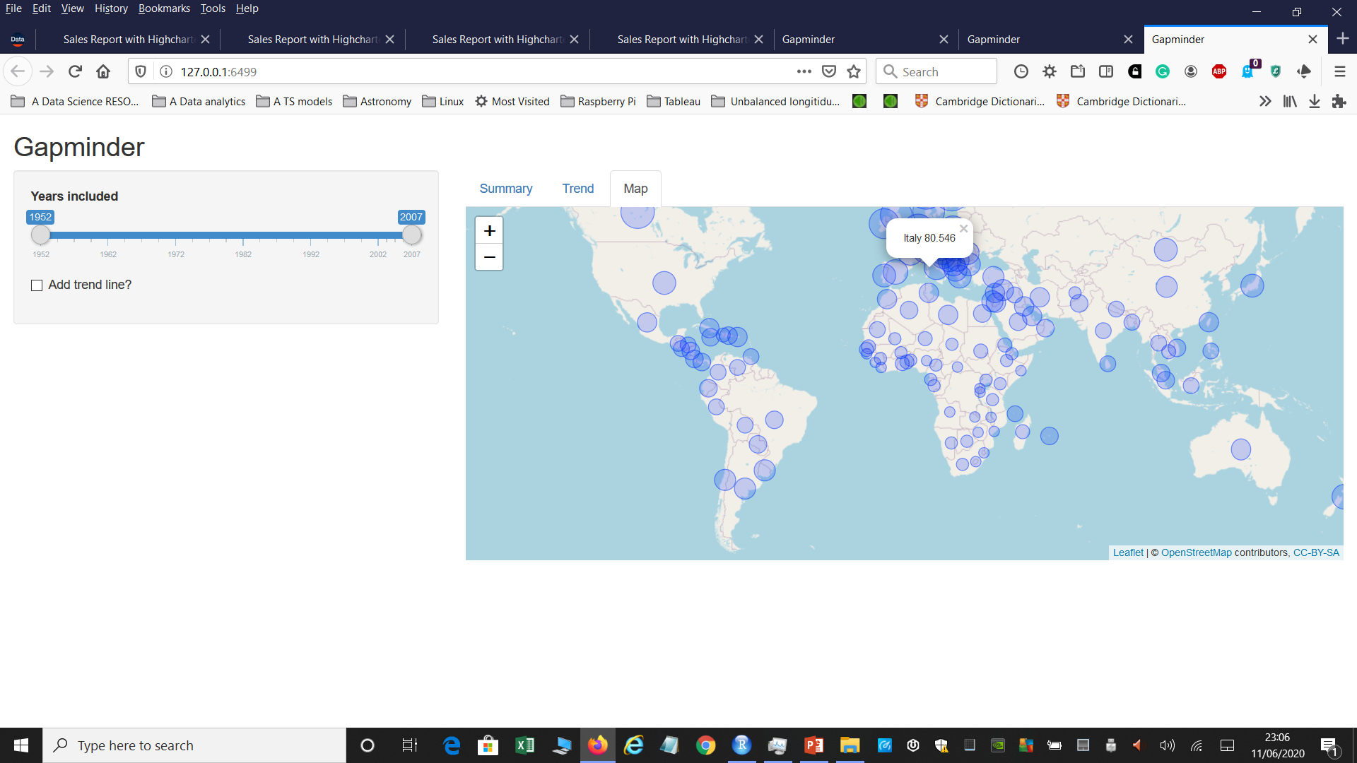
GAPMINDER Shiny APP
This Shiny app includes a slider menu on the left and two tabs a line chart and map
Both line and map visualizations are interactive charts and reac to input time variable on the left hand side of the app
The app is launched and displayed on a normal web browser and it can include chunks of CSS, html and Javascript code.

Slide 10
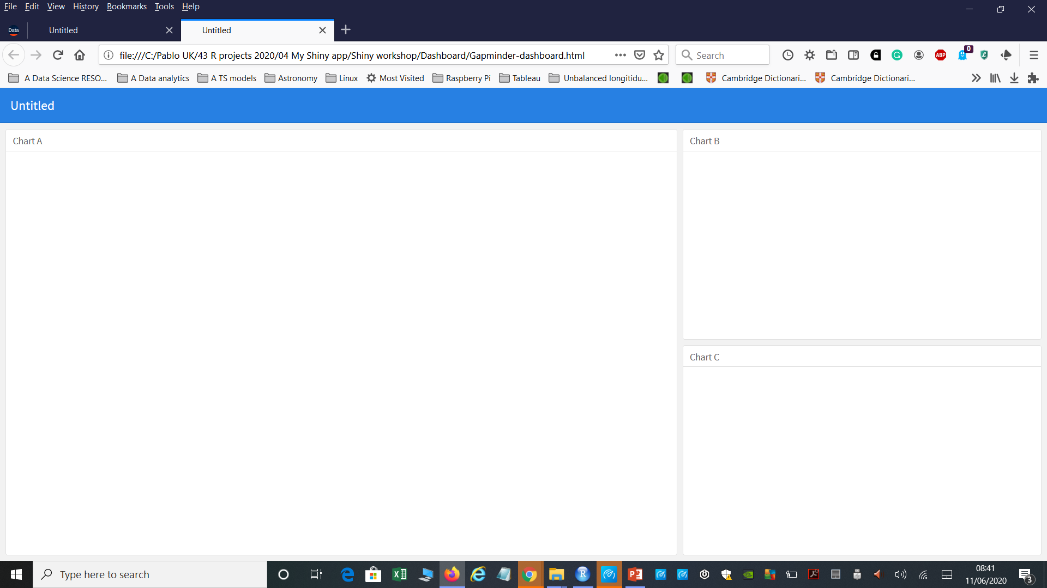
Flexdashboards in R (based on Markdown boiler template)
Script
---
title: "Untitled"
output:
flexdashboard::flex_dashboard:
orientation: columns
vertical_layout: fill
---
```{r setup, include=FALSE}
library(flexdashboard)
```
Column {data-width=650}
-----------------------------------------------------------------------
### Chart A
```{r}
```
Column {data-width=350}
-----------------------------------------------------------------------
### Chart B
```{r}
```
### Chart C
```{r}
``
Dashboard template

Slide 11
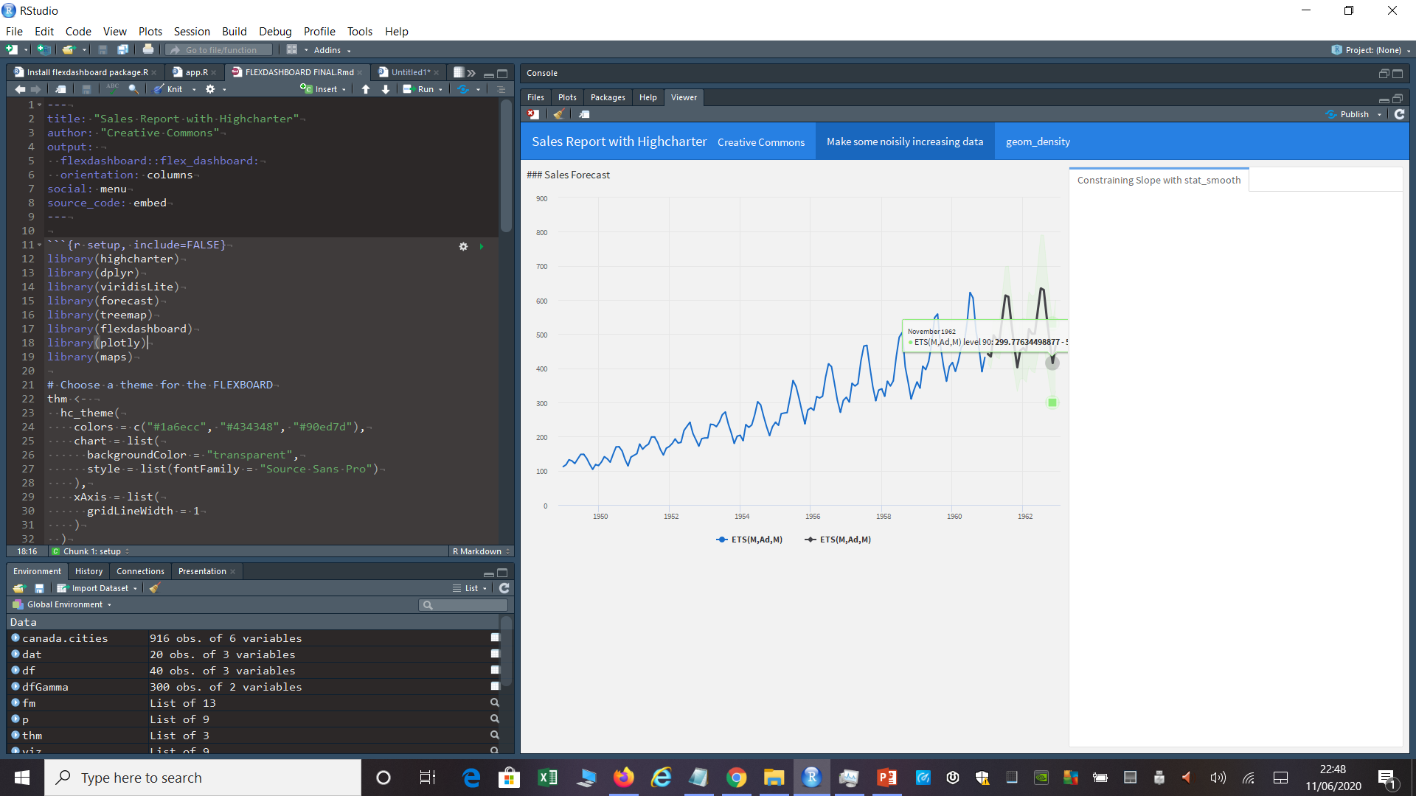
Dashboard 01-02, Building up each viz

Slide 12
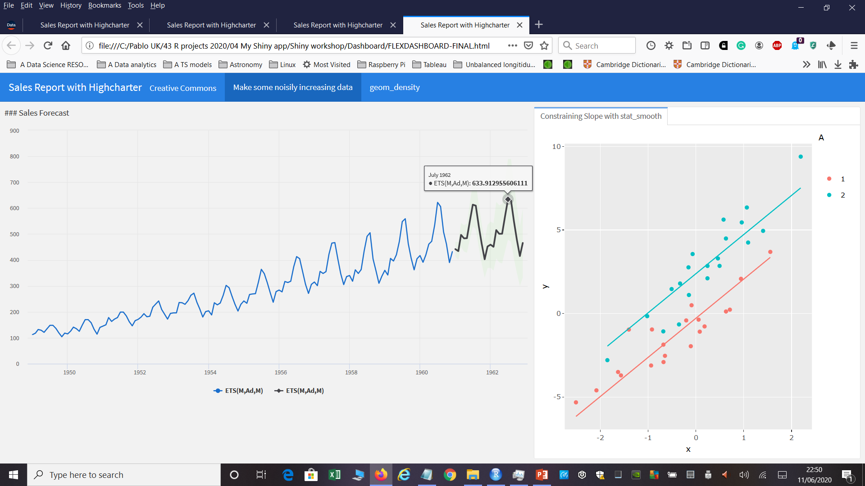
Dashboard 02-02, displaying it on a web browser
Interactive dashboard that opens on a web browser. Tooltips and highlight tools enabled from plotly package.

Slide 13
App launcher
App launcher.R
This script is used to execute each of the apps
Each app must be on a different folder, use this folder for Project Name “Gapm app”
To identify app scripts from other R scripts, end project folder title with “ app”
Within each folder the only existing file must always be called "app.R"
Use a different folder name to identify different apps
Launch all apps from folder level that includes a different folder for each Shiny app
library(shiny)
# Minimal example app
# Folder
runApp("Minim app")

Slide 14
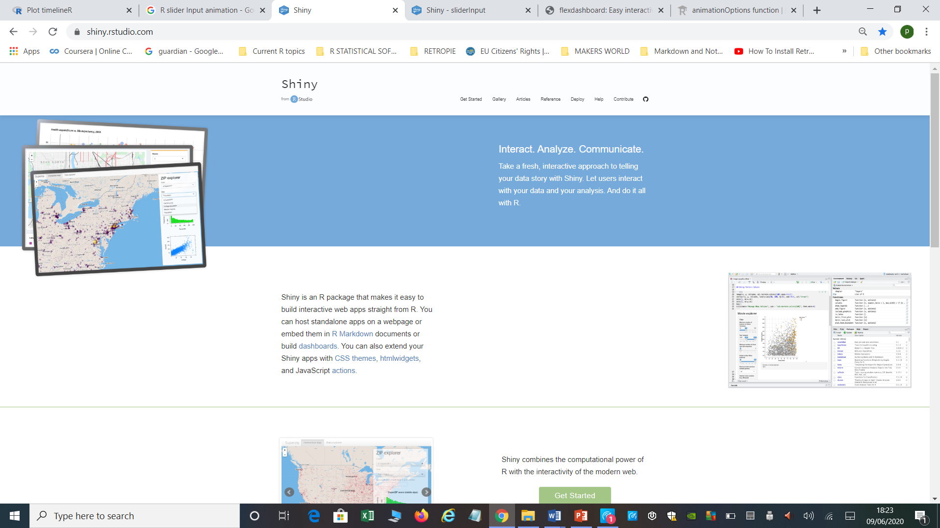
Shiny package website
Shiny apps website
https://shiny.rstudio.com/

Slide 15
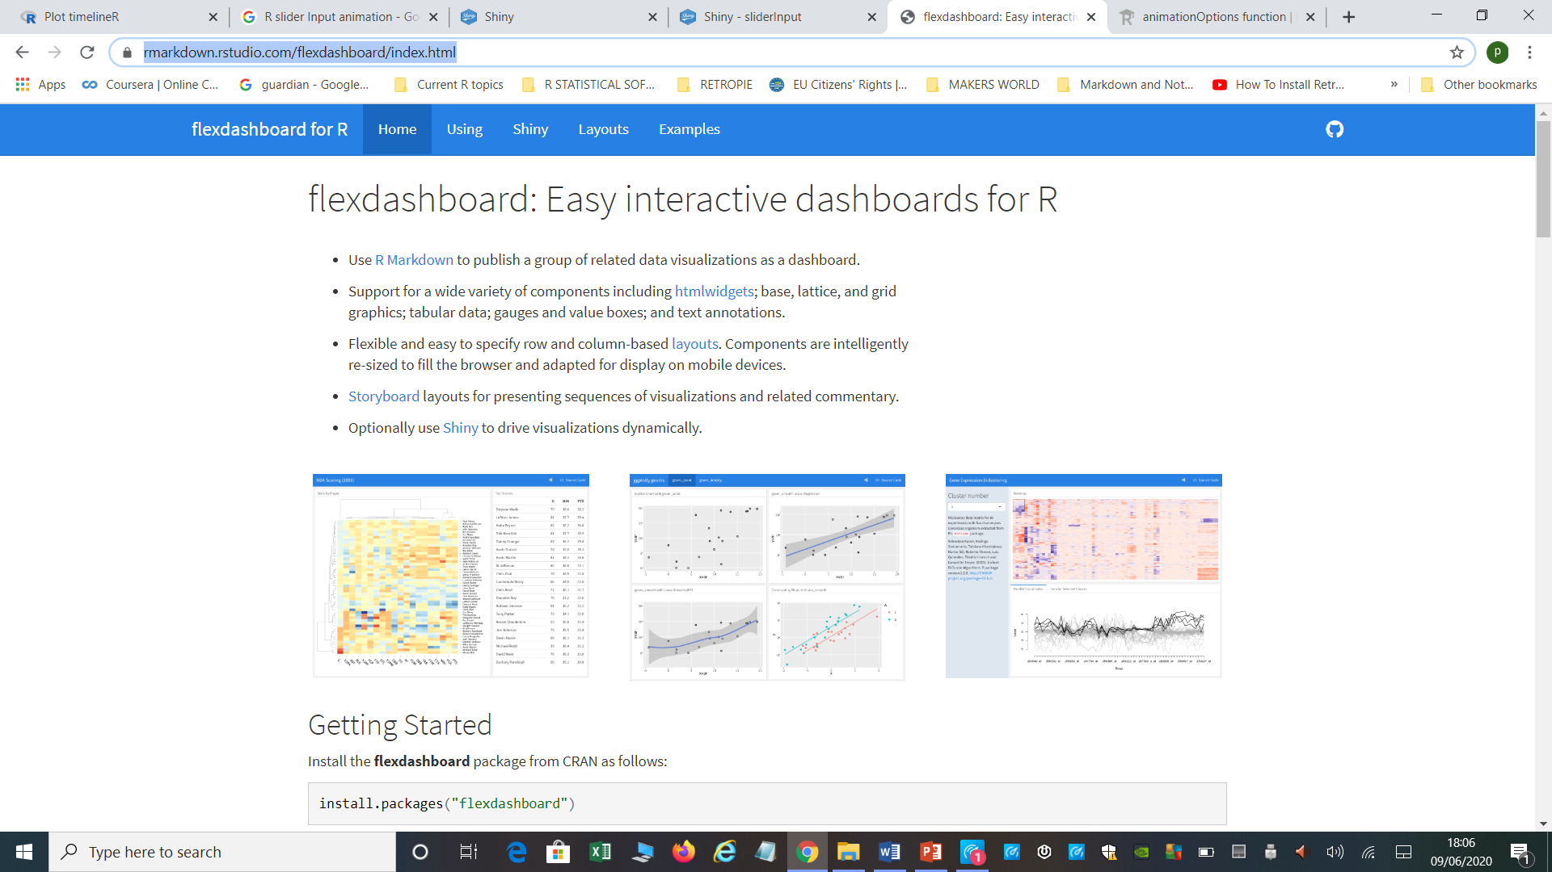
Flexdashboards
Build interactive dashboards in R
Support for a wide variety of components including htmlwidgets; base, lattice, and grid graphics; tabular data; gauges and value boxes; and text annotations.
Flexible and easy to specify row and column-based layouts. Components are intelligently re-sized to fill the browser and adapted for display on mobile devices.
https://rmarkdown.rstudio.com/flexdashboard/index.html

Slide 16
Further topics
GOLEM
This is an specific package created by Colin Fay from ThinkR to build robust Shiny apps
https://thinkr-open.github.io/golem/
https://github.com/ThinkR-open/golem
Shiny Gallery
https://shiny.rstudio.com/gallery/
Current Example. MSF COVID-19 Epi
https://rdrr.io/github/epicentre-msf/covid19/f/README.md

